Slide 1
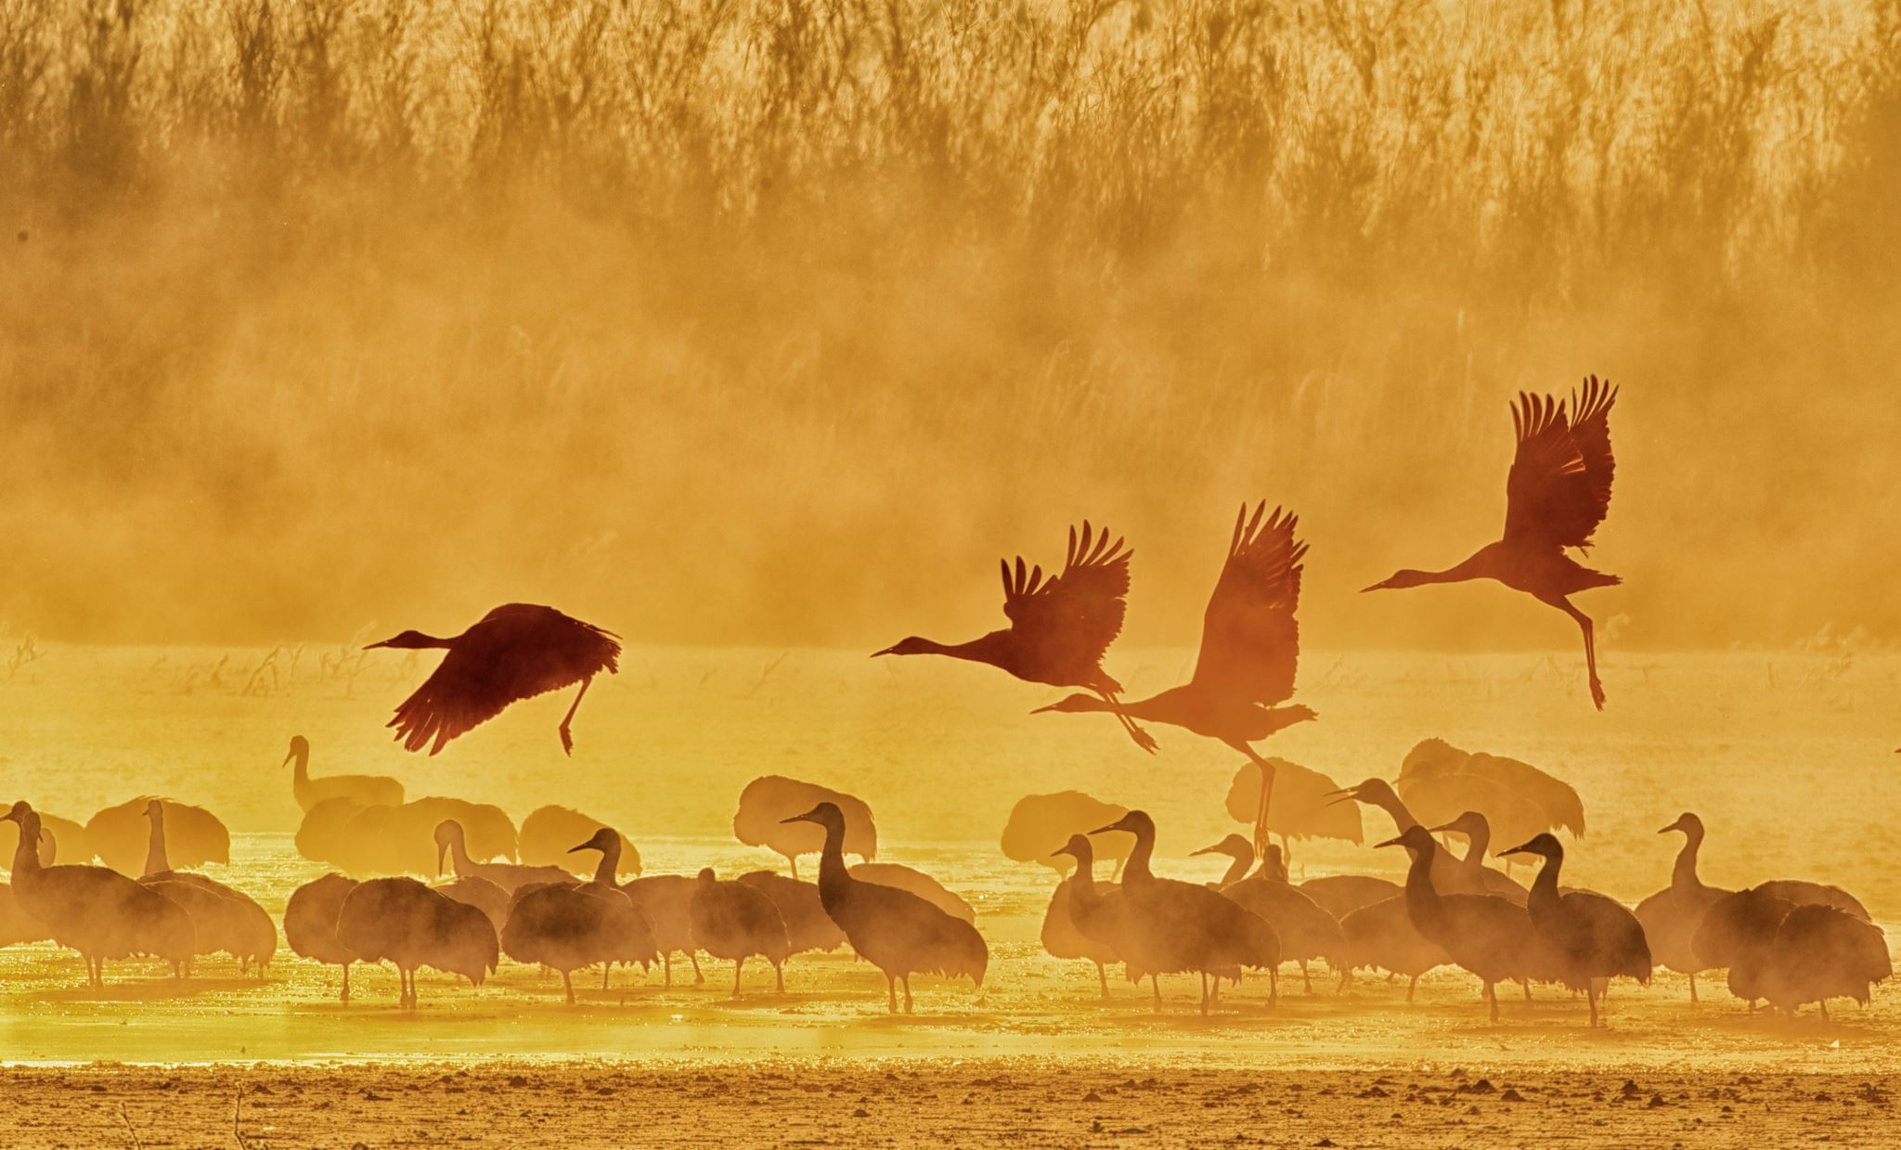
Wing Beats to Data Feats: Analyzing & Visualizing Migratory Bird Trends
Team Wild Ducks

Slide 2



TEAM MEMBERS
Sai Kadambari Developer
David Akers Product Owner
Gregg Rich Developer
Brian Monter Developer
Sean Lam Scrum Master
Ashley Atzingen Developer

Slide 3
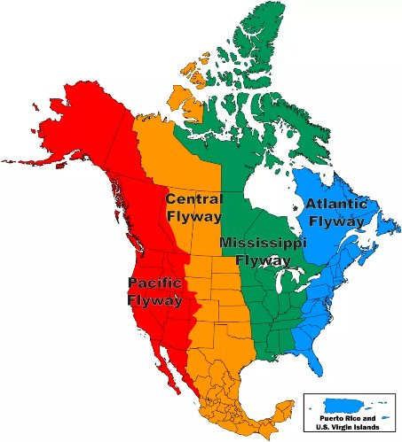
The U.S. Fish & Wildlife Service is the federal agency responsible for the conservation and management of fish, wildlife, plants, and their habitats for the United States.
Starting in the 1952-53 season, the U.S. Fish and Wildlife Service (FWS) has conducted a survey among Federal Duck Stamp purchasers to assess waterfowl hunting activities and harvest across the United States
To effectively manage and protect migratory game birds, the DMBM operates within a structured framework known as Flyways – major geographical corridors that birds follow during migration
Partner background: US Fish & Wildlife service
Primary Partner POC: Steve Olsen (Pacific Flyway)

Slide 4

PROBLEM STATEMENT
Mission Statement:
Division of Migratory Bird Management (DMBM) collects and analyze population and harvest data on migratory game birds for the annual public reports known as the ”Flyway Data Books”.
2. Current State:
Each of the four Flyways has a separate Data Books and set of data tables. Annually, the manual process of appending the estimates for each of the Flyways is time consuming, labor intensive, and prone to errors as well as data inconsistences. There's also been little analysis applied to the data and it's not user-friendly.
3. Project Goals:
Improve Efficiency: Tools/Processes to Produce Harvest Reports Are Inefficient
Reduce Errors: Tools/Processes to Produce Harvest Reports are Error Prone
Create Value: Users Aren’t Able to Realize the Full Value of Harvest Reports
4. Problem Domains:
Data Engineering
Data Analytics
Data Visualization and Reporting

Slide 5
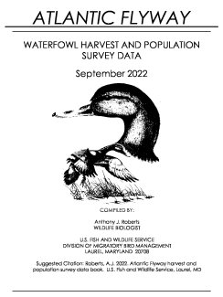
DATASETS
Harvest estimates and hunter data (primary)
Dataset Owner: Division of Migratory Bird Management
Dataset Type: public CSV file
Dataset Size: 782 MB
Flyway GeoJSON Files
Dataset Owner: Division of Migratory Bird Management
Dataset Type: public, geojson files
URL: https://gis-fws.opendata.arcgis.com/datasets/857fe0c9f3fc4e848e905fb24c487d36/explore?location=8.971628%2C-134.326345%2C7.66
Previous year Data Book from the Atlantic Flyway for reference
Dataset Owner: Division of Migratory Bird Management
Dataset Type: public, PDF
URL: https://www.fws.gov/media/migratory-bird-atlantic-flyway-data-book
Notes:
Data source for generating tables and visualizations
GeoJSON for outlining Flyway boundaries for visualization
Ground Truth – Formatting guide and data verification

Slide 6
HARVEST DATASET
5,900,720 rows X 16 features
Identifiers
Part ID
PCS Hunter ID
AOU Number
Temporal
Season
Harvest Year
Harvest Month
Spatial
Flyway Name
Species Name
Species Code
State Code
Harvest Day
Flyway Code
Characteristics
Age Char
Sex Char
Cohort
Harvest Weight
Null​ | Duplicate​ | Invalid​
95,640 rows​ | 0​ | 0​
Notes:
Primary data source – derived from Parts Collection Survey (Wing Survey)
Harvest_weight: derived from sampling frame – establishes weight of a given record (row) for aggregation
Null values insignificant, limited to month, day or imputable from redundancies inherent to dataset
Season – considered the relevant time period for all FWS publications/visualizations

Slide 7
HUNTER DATASET
9,797 rows X 22 features
Feature Name​ | Null​ | Description​ | Domain Values​
sp_group_estimated​ | 0​ | Common name of species or species group for which harvest estimates are calculated​ | ['brant’, 'ducks’, 'geese’, 'sea ducks']​
sp_group_surveyed​ | 0​ | 4-character code representing the survey instrument. ​ | We are only interested in WATF​
season​ | 0​ | Year representing the beginning of the hunting season​ | 1999 to 2020​
mgmt_unit​ ​ | 0​ | The management units are defined as the flyways​ | ['AF' 'PF' 'AK' 'US' 'MF' 'CF']​
survey_state​ | 0​ | Two-letter United States state codes​ | Examples: 'CT' 'DE' 'MD' 'MA' 'NJ' 'NY' 'NC' 'RI' 'VA' 'AF' 'CA' 'OR' 'WA' 'PF' ‘AK’​
bag_per_hunter​ | 0​ | Estimate of the number of birds shot and retrieved per hunter​ | Float values​
active_hunters​ | 0​ | Estimate of the number of active​ | Float values​
days_hunted​ | 0​ | Number of hunting days.​ | Float values​
Notes:
Hunter data set – complements but does not duplicate information
Derived from Hunter Survey – provides species, state, and flyway level data from the hunter’s perspective
Estimates derived from sampling frame (dataset also reports variance and confidence intervals for last three variables)

Slide 8

OVERALL DATA QUALITY ASSESSMENT
Completeness | High | The data is highly complete; only 5 features contain missing NA values. In all, the top 3 are Harvest Month (1.6%), Harvest Day (1.6%), Hunter ID (0.1%).
Uniqueness | High | Each observation is independent and uniquely identified by a Part ID. There are no duplicate observations found in the dataset.
Accuracy | Medium High | This dataset is provided by the Division of Migratory Bird Management, an authoritative information source. It is based primarily on reported and survey data. EDA revealed minor inconsistencies and missing date values.
Conformity | High | Exploratory data analysis (EDA) did not reveal nonconformity across the data features. Data is consistently formatted for all features, such as for dates and coded values.
Notes:
DQ describes WingData, no missing values in Hunter_Dataset

Slide 9
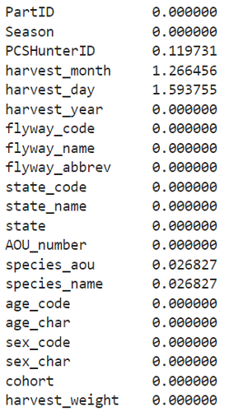
DATASET CONDITIONING
Imputing missing values - The 1,583 NA values for the variables species_aou and species_name were able to be imputed using the values from the variable aou_number, using the USGS Species Table and Recommended Band Sizes as a lookup table.
Recoding variables - Several variables should be coded with strings are numerically encoded, e.g., harvest_month (1.0, 2.0, etc. Format, not Jan, Feb, etc.).
Binning variables - The cohort variable shows nine categories, many of which are rare and/or unknown, making them candidates to re-bin. E.g., Combine ‘unknown male’ with a larger, meaningful category like ‘immature male’ OR combining male/female ‘unknowns’ into new unknown categories.
Other missing or NA values - Since the data will be primarily aggregated on the year, state, species, and flyway variables, missing values for month and day will be ignored.
Create new variables. A variable, ‘is_duck’, was created to facilitate the aggregation of data from several species that belong to the duck category, specified by the client. All other aggregations could be done at the level of individual species.
% missing values by feature

Slide 10

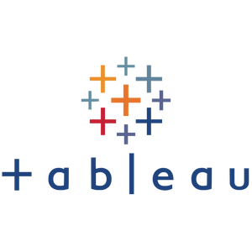


POTENTIAL ANALYTICS/ALGORITHMS
Analytic/Algorithm Name:
Data Cleaning & Integration
Data Report Generation
Data Visualization
ARIMA model for predictive analytics
Computer and Software Resources Required:
Tableau & Tableau Public Hosting
Python & Pandas
Google Colaboratory & Github
OpenPYXL (Excel Generation)
Testing:
Manual and visual testing
Customer acceptance testing
Notes:
Through out the course this project, we used the following analytical techniques:
Data cleaning and integration where we performed data wrangling and exploratory data analysis
Data Report Generation where we transformed raw data into hundreds of data tables for the Flyway Data Books
We applied visual techniques to build out interactive information dashboards.
And lastly, the ARIMA predictive model was used to forecast the future Hunter data numbers.
The software tools the team used included
Tableau desktop and Tableau public for hosting.
Python and Pandas for data analysis.
Google Collab & Github for collaboration,
and Python OpenPYXL for Excel table generation.
Both manual and visual testing methods were carried out. We also performed customer acceptance testing during the weekly partner meetings.

Slide 11
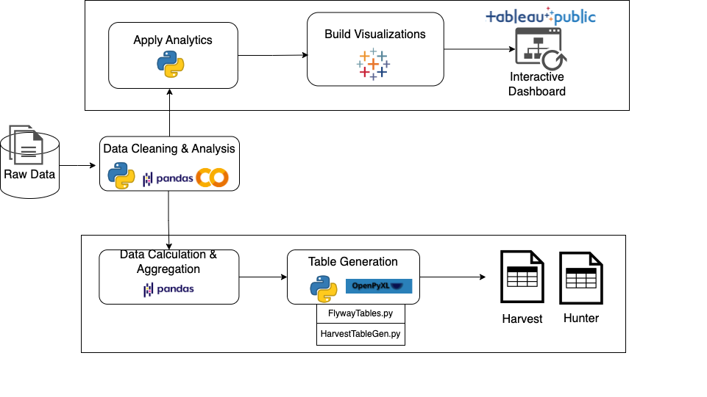

SOLUTION DIAGRAM
Notes:
This diagram depicts the high-level two-pronged solution to achieve our project objectives.
Start from the left with the raw data. Here, data cleaning, wrangling, and data analysis are carried out
In the next step, two separate paths were taken.
On the top, we applied further analysis and built out 3 interactive visual dashboards in Tableau. The final dashboard products were published to Tableau Public for distribution.
On the bottom path, we performed calculations in Python and developed two table generation scripts for Harvest and Hunter data. The final outputs are Excel workbook files with hundreds of generated tables.

Slide 12
HARVEST & HUNTER TABLE GENERATION SCRIPT
HarvestTableGen.exe and HunterTableGen.exe are user-friendly Python scripts for the automatic generation of Flyway Databook harvest and hunter data tables.
They are programmed with a simple user command-line interface comprising of arguments, script options, and a complete help menu.
User can specify flyway region, range of hunting seasons, species list, and species groupings for table generation.
HarvestTableGen.exe and HunterTableGen.exe are built with flexible user options; it can be reused and repeated on annual harvest data from year to year. Output is repeatable and consistent.
Time periods are dynamically determined, and period averages are automatically calculated based on the hunting season range user input.
Prompt user inputs and script options
Validate and parse user inputs
Read in data file
Clean data
Calculate harvest data by species and group of species
Determine and calculate time period averages
Output tables to Excel workbook
Notes:
For table generation, the team developed two Python executable scripts called the HarvestTableGen and HunterTableGen. Both the scripts are equipped with a command-line interface or CLI.
The primary goal is to create an automated, repeatable, and consistent process to generate the customer Flyway Data Book tables every year
As part of the workflow, the script prompts user for inputs. It then parses and validates the inputs. Next it reads in the data file, performs data cleaning, calculates table data and averages for each species group. And lastly output all the tables to an Excel workbook for a Flyway region.

Slide 13
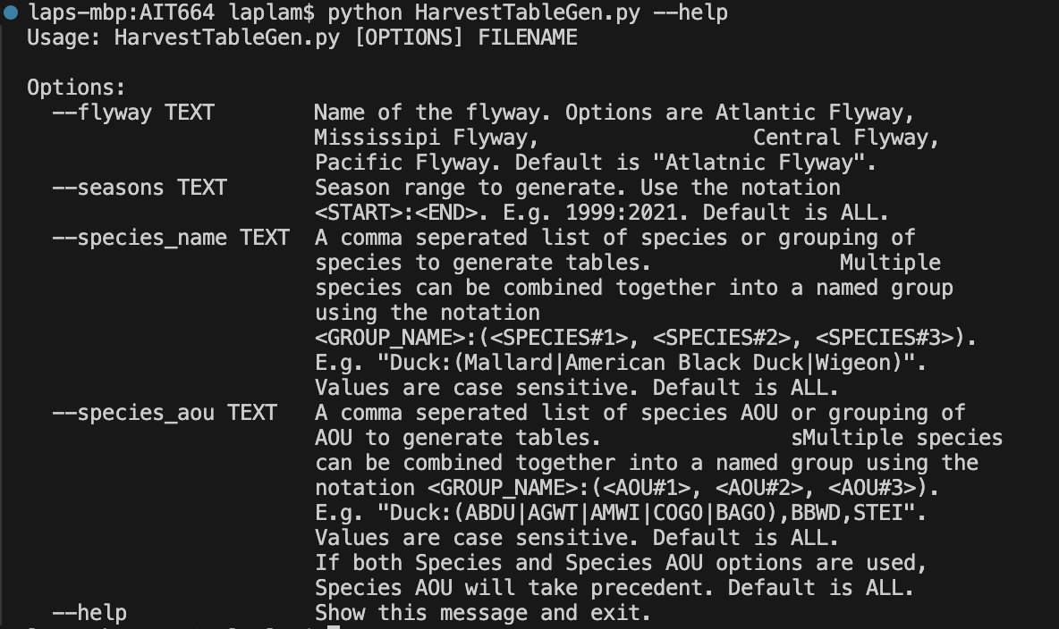
HarvestTableGen.exe Command-line Interface (CLI) usage example
Using the @Click Python Library extension, HarvestTableGen.exe provides a user-friendly command-line interface (CLI) with a complete –help menu:
FILENAME is a required argument that must be passed in. This is the harvest data CSV file.
There are 4 available command-line options: flyway, seasons, species_name, and species_aou
Option flyway --> "Atlantic Flyway"
Option season --> "1999:2021"
Option species_name --> "Duck:(Mallard|American Black Duck|Wigeon), Snow Goose, Black Scoter".
Option species_aou --> "Duck:(ABDU|AGWT|AMWI|COGO|BAGO),BBWD,STEI"
Notes:
In this slide, we take a closer look at what the script user command-line-interface looks like.
Passing in NO arguments, a complete help menu is displayed as you can see in the picture. FILENAME is a required argument along with 4 options. Flyway, seasons, species name and species AOU.
As an example, the season is specified as a range using the colon notation. The species name is a comma separated list. Grouping of species can be done using the parenthesis and pipe notation. Alternatively, the species AOU option can be used in place of species name.

Slide 14
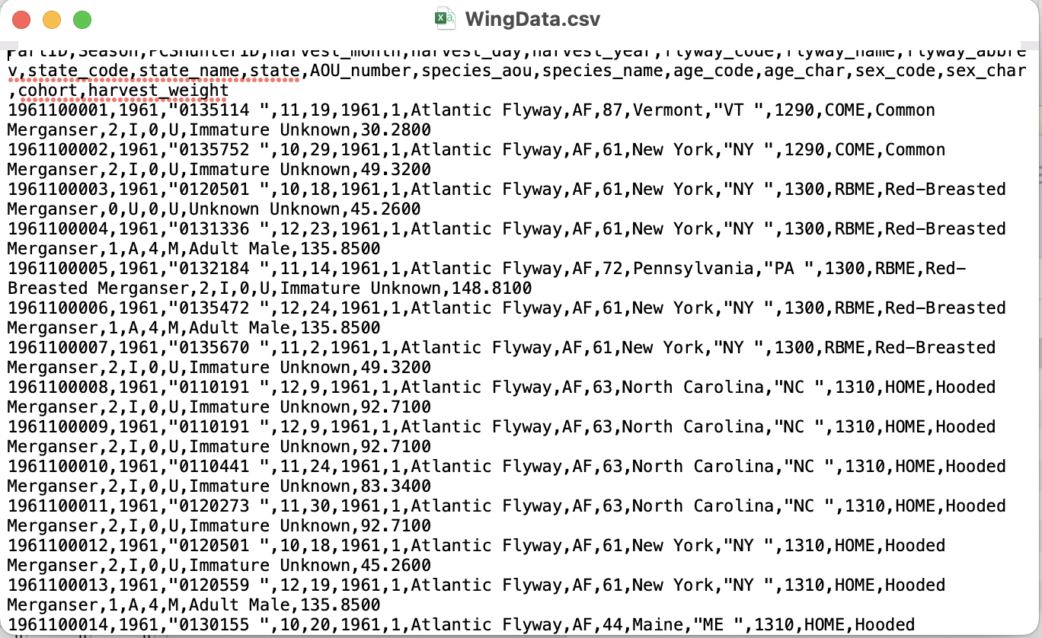
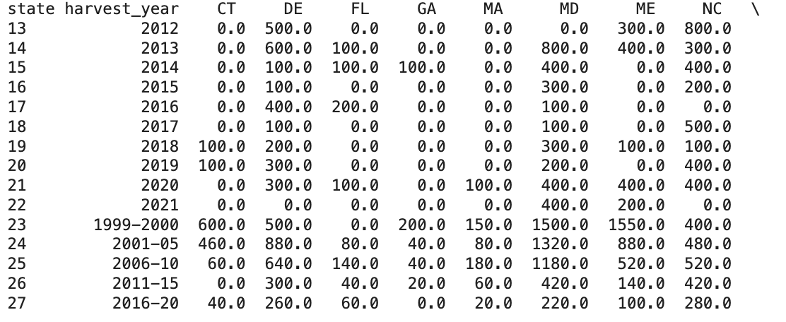
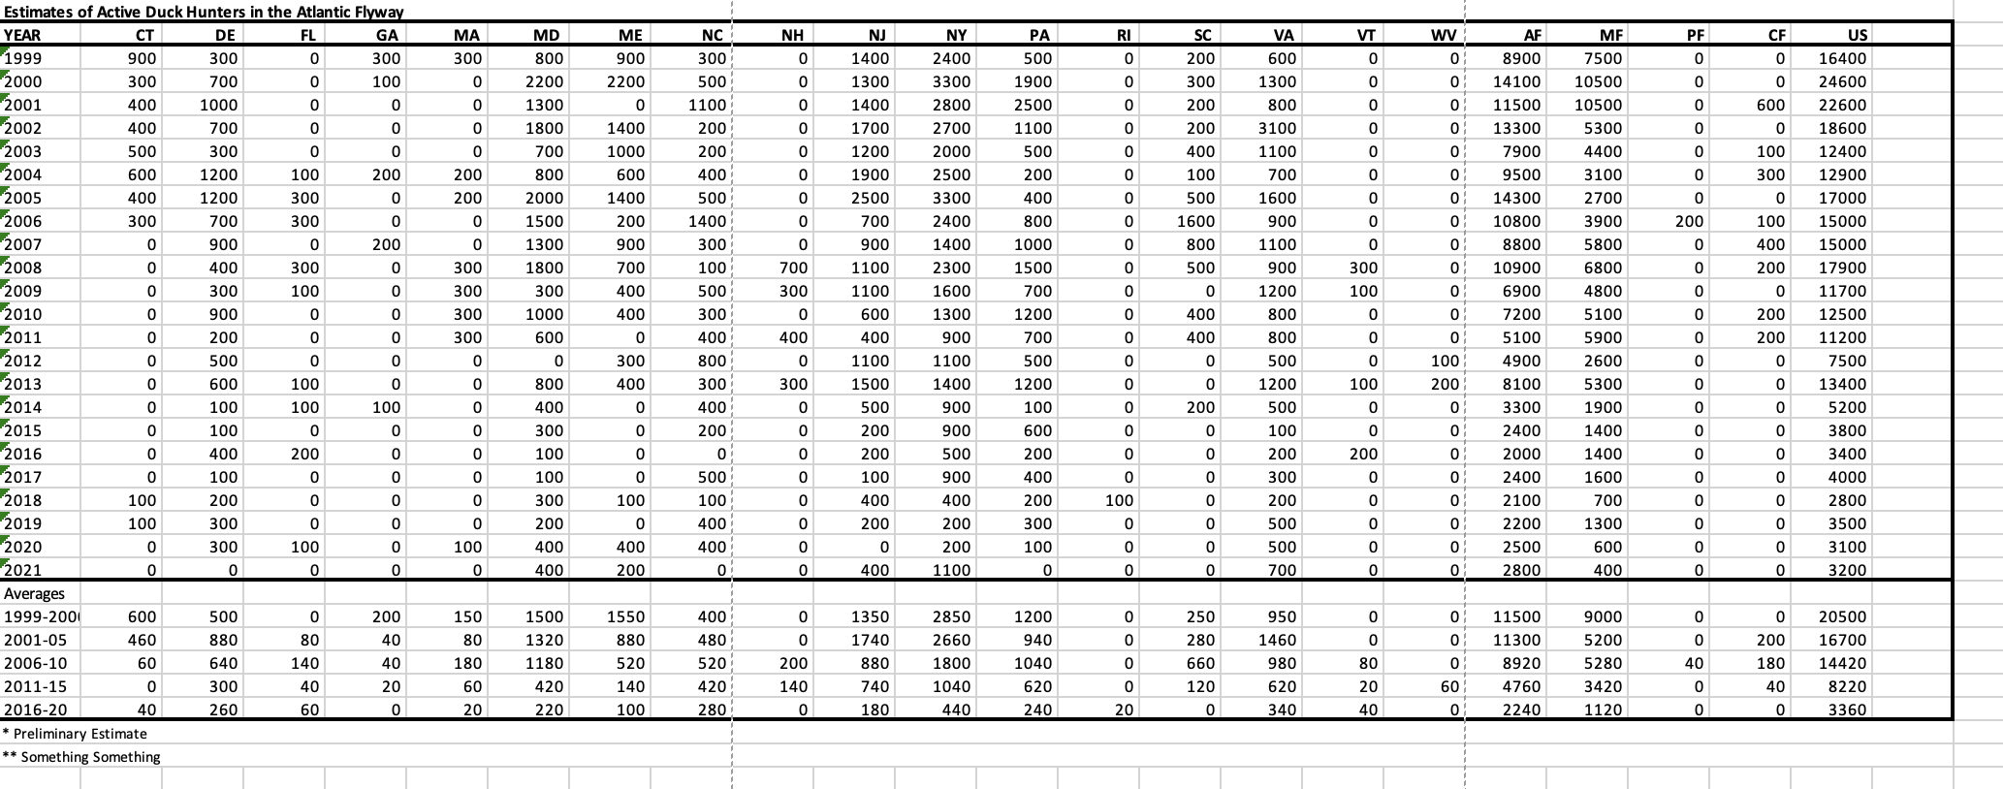
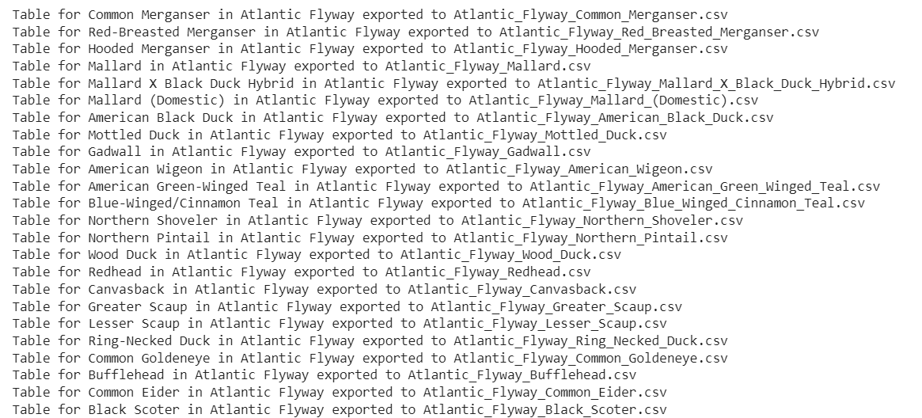
SAMPLE AUTO-GENERATED TABLE OUTPUT
2. Clean and Analysis
1. Raw Data
4. Export Excel Tables
3. Table Generation
Notes:
Here is a sample output of the script through each phase of its execution.
Starting with the raw data, it performs cleaning and calculations. It then generates tables in memory and lastly output them to Excel tables. As you see in step 4, this table matches exactly the formatting and style of our customer’s Flyway Data Books

Slide 15
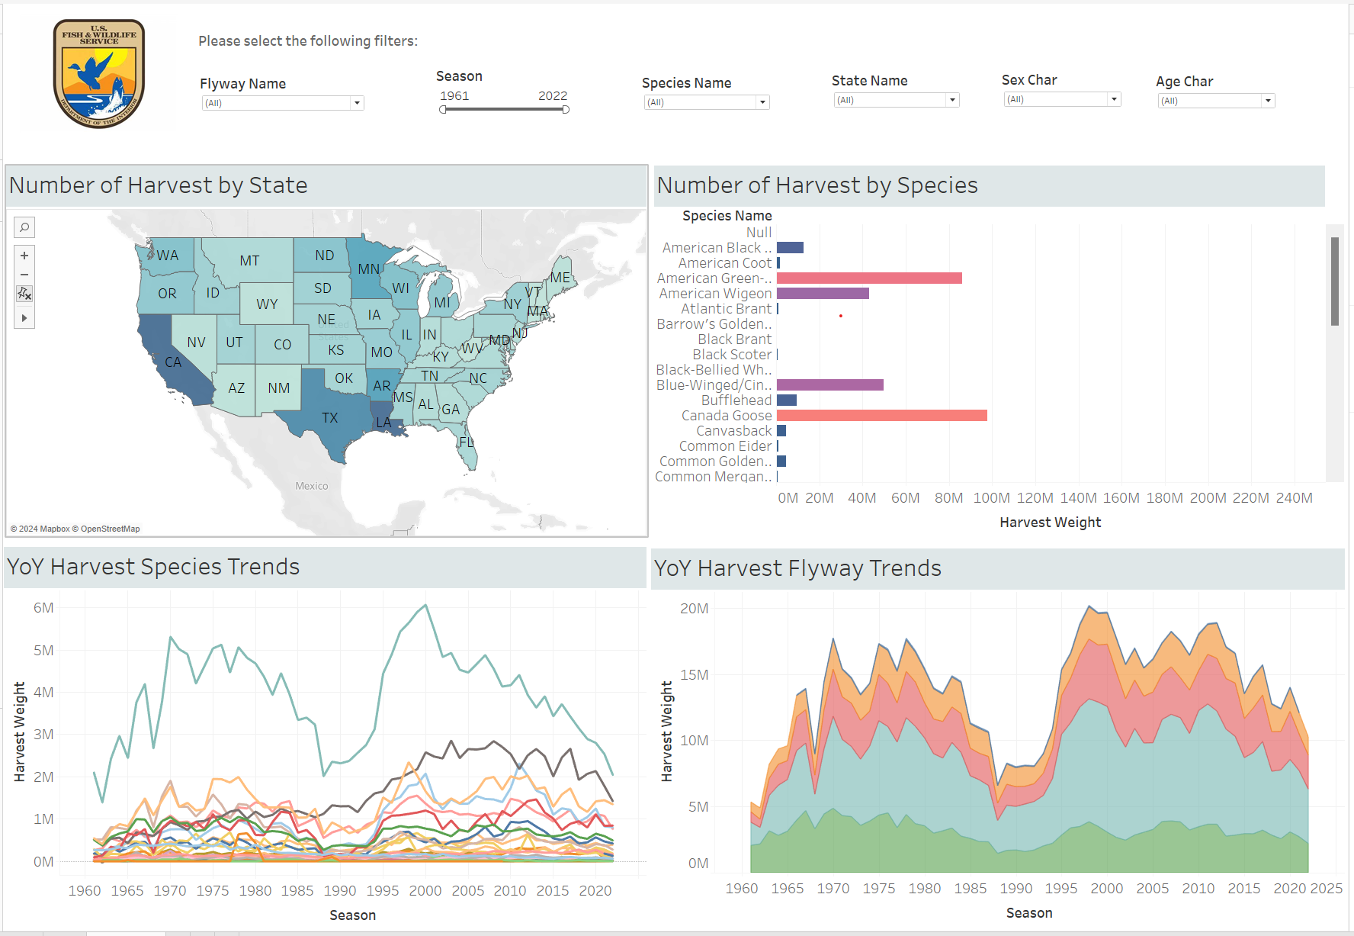
HARVEST DASHBOARD #1
Notes:
Brian

Slide 16
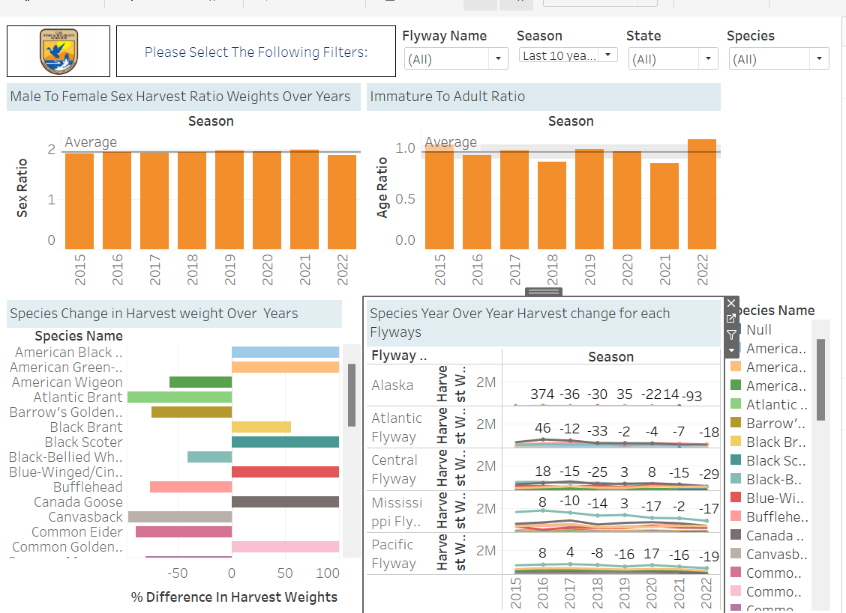
HARVEST DASHBOARD #2
Notes:
Sai

Slide 17
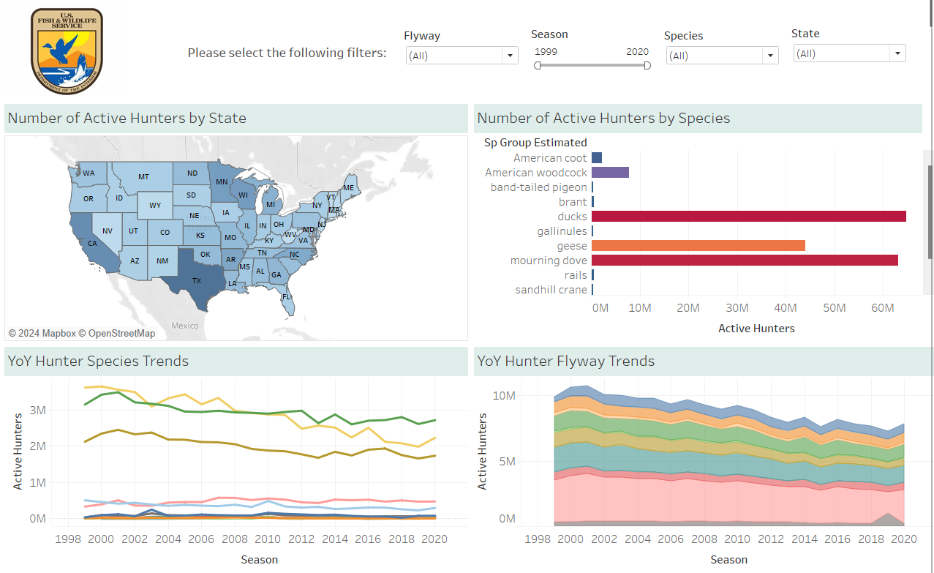
HUNTER DASHBOARD

Slide 18
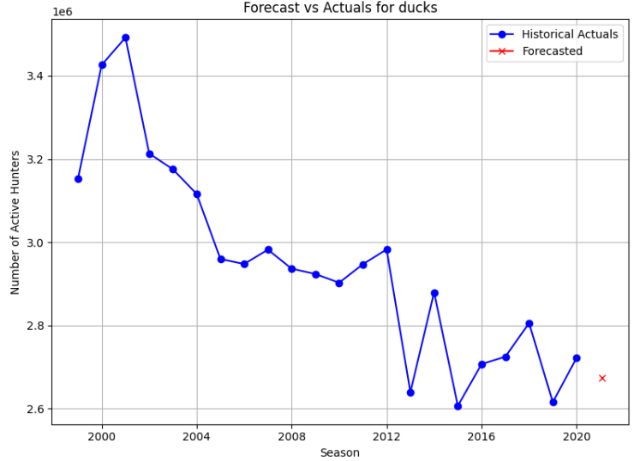
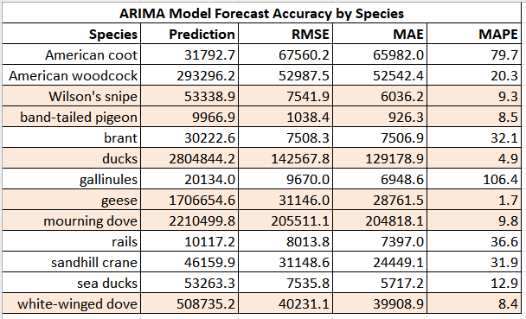
Forecasted Active Hunters by Species: ARIMA Model
Model Explanation: ARIMA accounts for past values (Auto Regressive), differences (Integrated), and prediction errors (Moving Average).
High Accuracy Forecasts: Species with highlighted rows in the table exceed 90% forecast accuracy.
Practical Insights: Enables wildlife management to anticipate hunter participation levels.
Varying Accuracy: Some species show over 90% accuracy, while others are highly inaccurate.
Influencing Factors: The variability in forecast accuracy suggests the impact of external variables not included in the model.
Enhanced Modeling: Future models could integrate additional data sources, such as habitat changes, policy impacts, and climate variables, to improve accuracy across all species.

Slide 19

PROJECT SUMMARY AND ACCOMPLISHMENTS
Automate Report Creation:
Developed and delivered both the HarvestTableGen and HunterTableGen table generation script to programmatically clean and create harvest tables across seasons, species, and flyways efficiently, correctly, and consistently from the harvest and hunter data sets.
Provided full user guide documentation with step-by-step instructions and examples to accompany final deliverables.
Built a Tableau Hunter dashboard using the Hunter Data based on customer specific needs.
Built two Tableau Harvest Data dashboards using the Harvest Data based on customer specific needs.
Built 4 ARIMA models to forecast the next year's active hunters and total harvest by species, state and species, and flyway and species.
Published visualization dashboards to Tableau Public hosting to demo and for sharing with partner.
Prepared final product deliverable package to provide to the partner team.
Completed Project Report writeup for submission.

Slide 20
FUTURE WORK
The team automated table creation, but there’s more automation opportunities on the backend.
Intake survey data from state/local partners.
ETL of data stored in sponsor’s SQL database, to avoid file sharing.
Little analysis of the data has historically been done, there’s likely untold narratives in the data or questions that can now be answered with novel data analysis.
Include additional descriptive statistics or create new statistics to report.
Pursue predictive analytics or forecasting by integrating new data sets with variables more likely (based on SME) to drive models.
A prototype dashboard’s been built to enable broader access to the data and enable nontechnical users to query the data, but self-service reporting can be taken further.
Add NLG or conversational AI to enable language-based queries as opposed to Tableau-embedded filters.
Limited visibility into precise end user needs.
Partner with the sponsor to launch a survey or interview different end users; the sponsor has limited visibility into how they use the data, this could surface additional use cases and help prioritize high/low value product requirements.

Slide 21
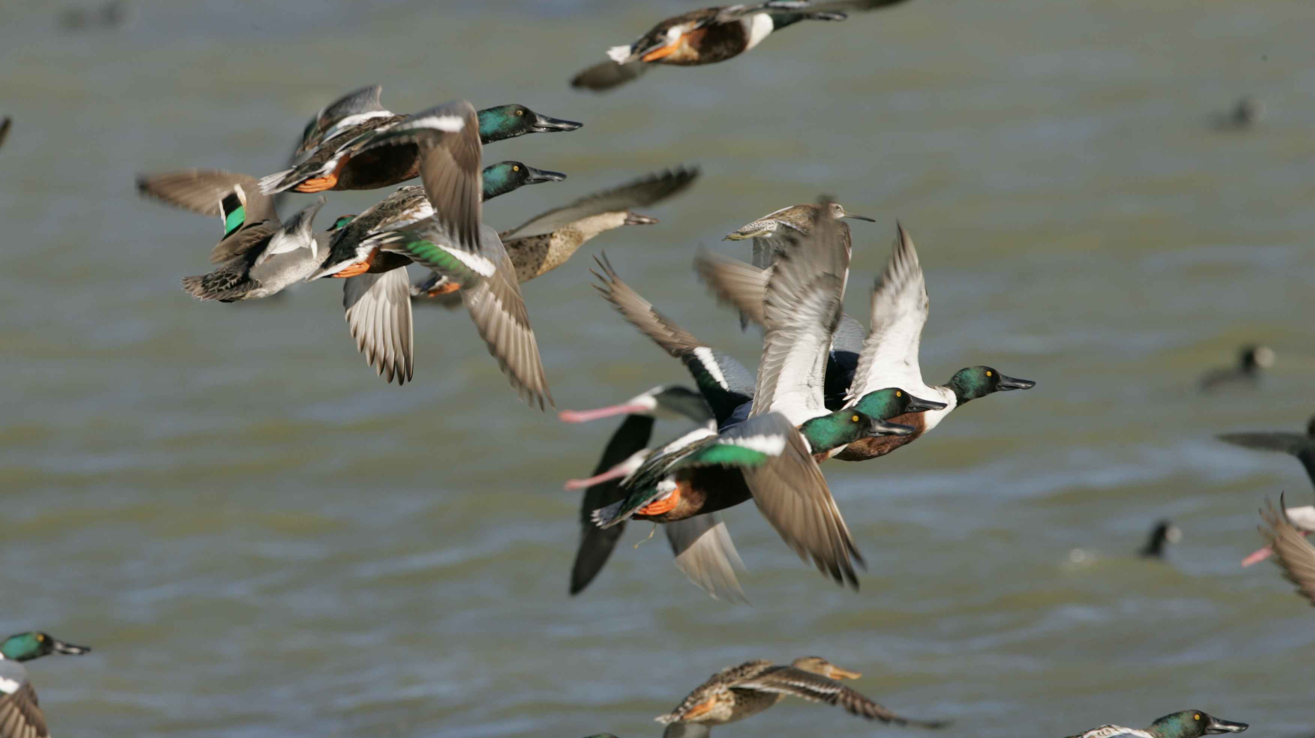
Questions?

